Slide 1
t-SNE и UMAP

Slide 2
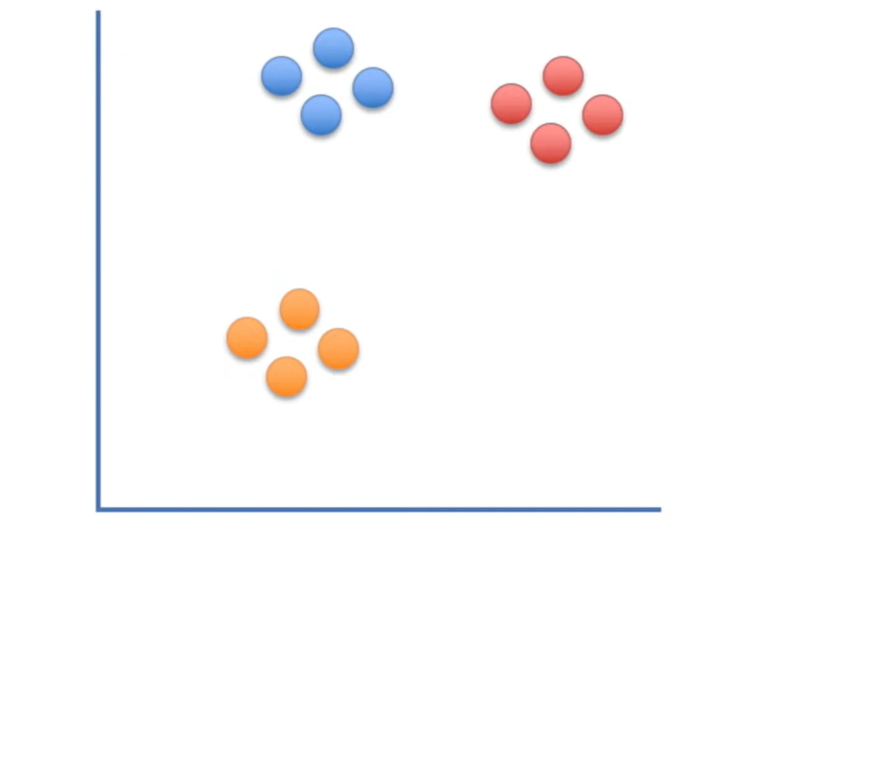
t-distributed Stochastic Neighbor Embedding

Slide 3
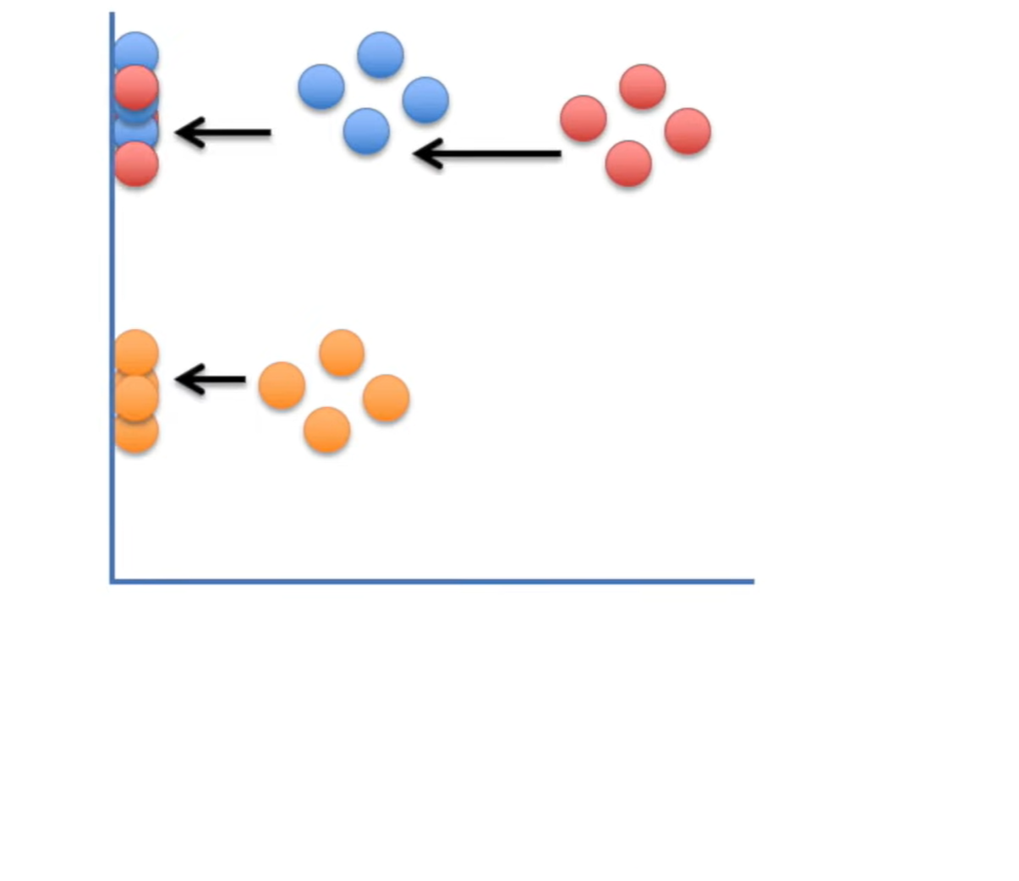
t-distributed Stochastic Neighbor Embedding

Slide 4
t-distributed Stochastic Neighbor Embedding
ГК

Slide 5
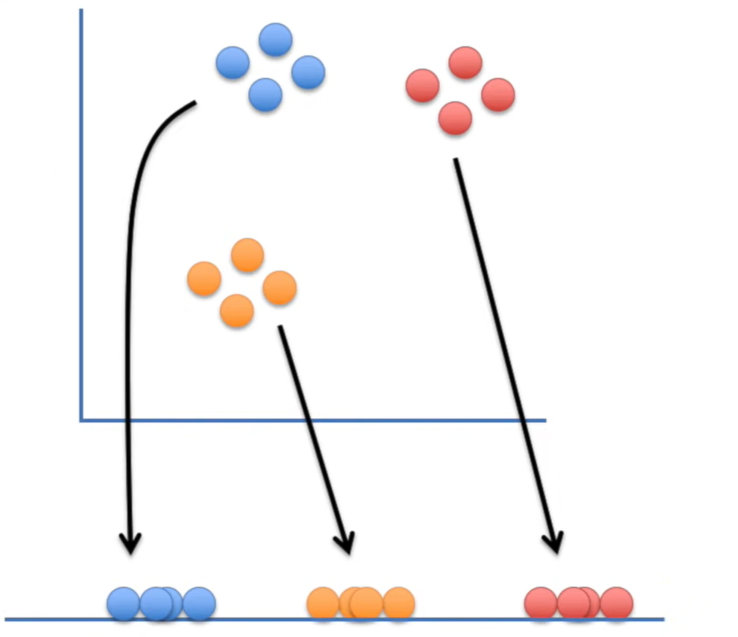
t-distributed Stochastic Neighbor Embedding

Slide 6
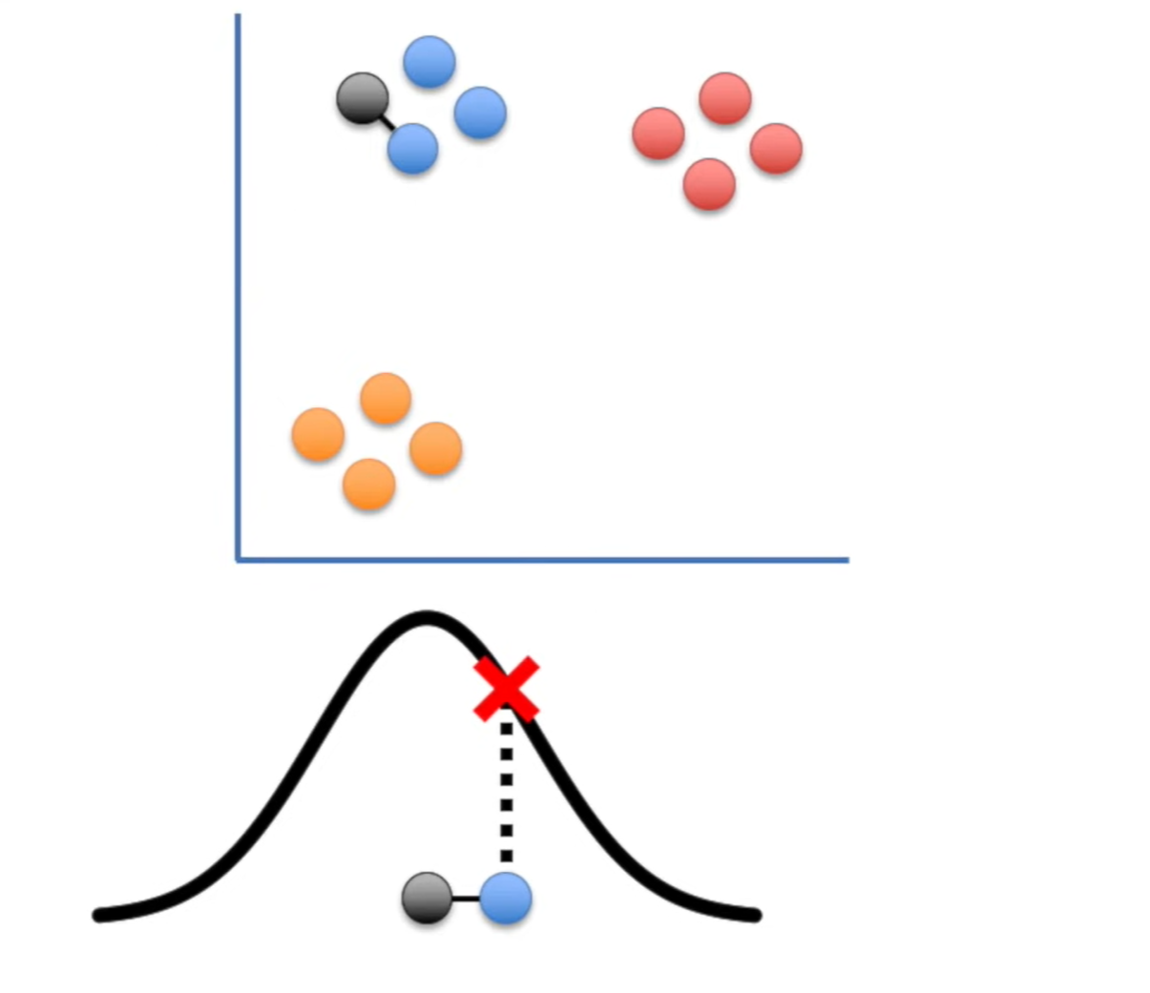
t-distributed Stochastic Neighbor Embedding

Slide 7
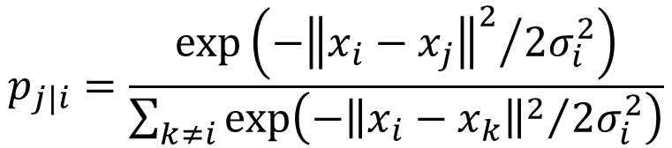
t-distributed Stochastic Neighbor Embedding
$$p_{j|i}=\frac{exp⁡\left({−{\left\|x_{i}−x_{j}\right\|}^{2}}/{2σ_{i}^{2}}\right)}{\sum_{k≠i}{exp⁡\left({−{\left\|x_{i}−x_{k}\right\|}^{2}}/{2σ_{i}^{2}}\right)}}$$

Slide 8
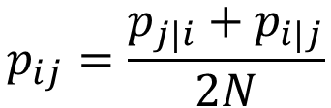
t-distributed Stochastic Neighbor Embedding
$$p_{j|i}=\frac{exp⁡\left({−{\left\|x_{i}−x_{j}\right\|}^{2}}/{2σ_{i}^{2}}\right)}{\sum_{k≠i}{exp⁡\left({−{\left\|x_{i}−x_{k}\right\|}^{2}}/{2σ_{i}^{2}}\right)}}$$
$$p_{ij}=\frac{p_{j|i}+p_{i|j}}{2N}$$

Slide 9
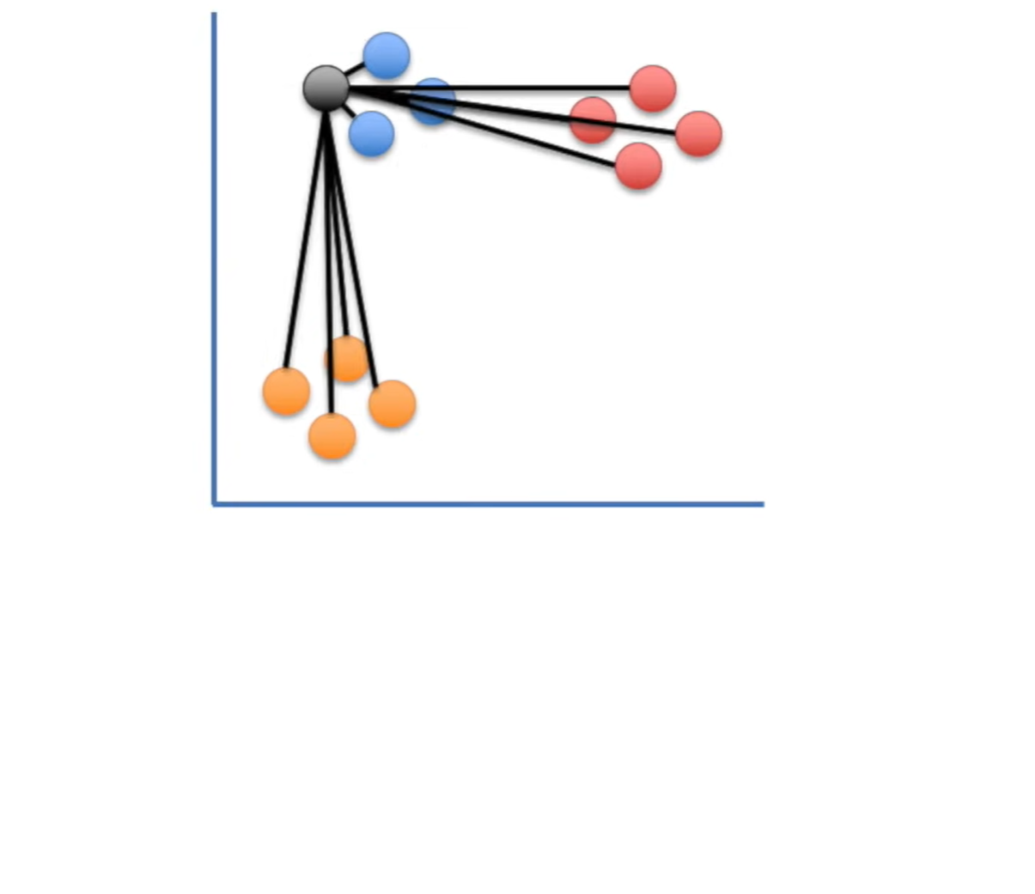
t-distributed Stochastic Neighbor Embedding
$$p_{j|i}=\frac{exp⁡\left({−{\left\|x_{i}−x_{j}\right\|}^{2}}/{2σ_{i}^{2}}\right)}{\sum_{k≠i}{exp⁡\left({−{\left\|x_{i}−x_{k}\right\|}^{2}}/{2σ_{i}^{2}}\right)}}$$
$$p_{ij}=\frac{p_{j|i}+p_{i|j}}{2N}$$

Slide 10
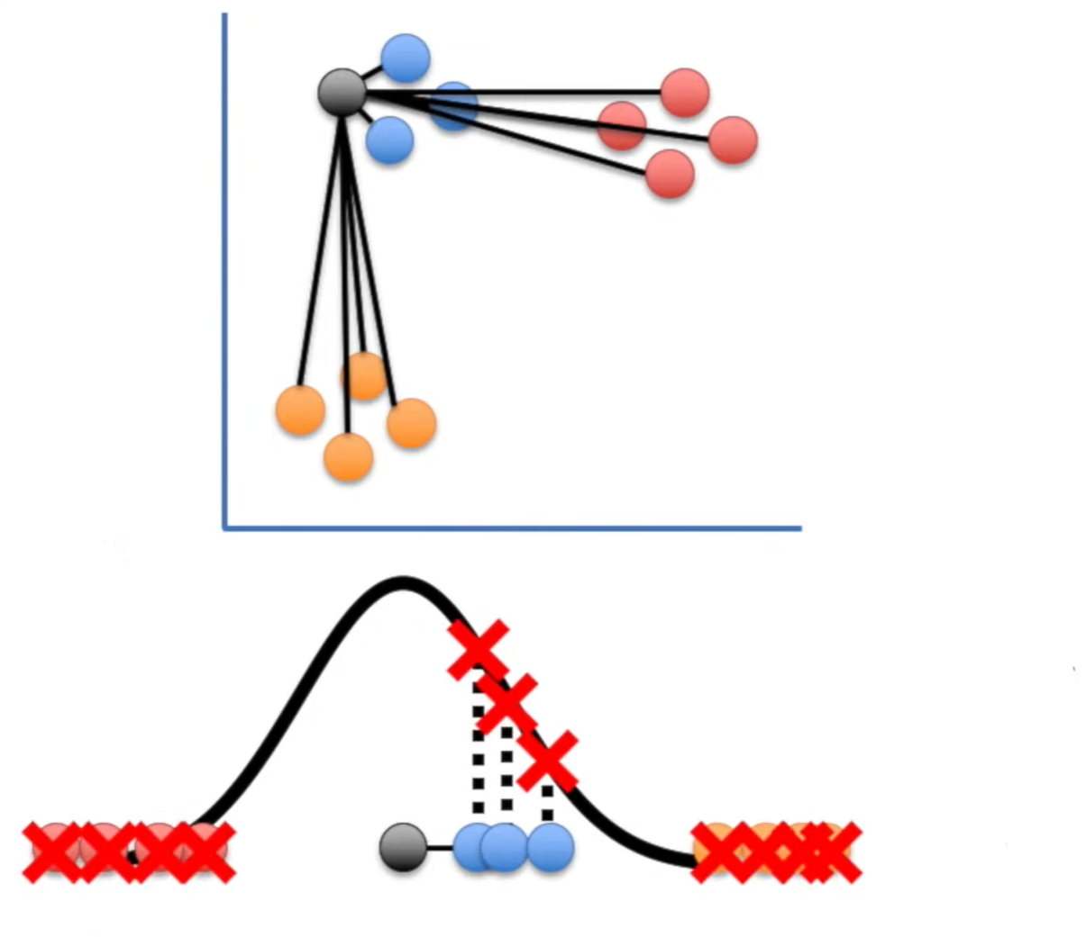
t-distributed Stochastic Neighbor Embedding
$$p_{j|i}=\frac{exp⁡\left({−{\left\|x_{i}−x_{j}\right\|}^{2}}/{2σ_{i}^{2}}\right)}{\sum_{k≠i}{exp⁡\left({−{\left\|x_{i}−x_{k}\right\|}^{2}}/{2σ_{i}^{2}}\right)}}$$
$$p_{ij}=\frac{p_{j|i}+p_{i|j}}{2N}$$

Slide 11
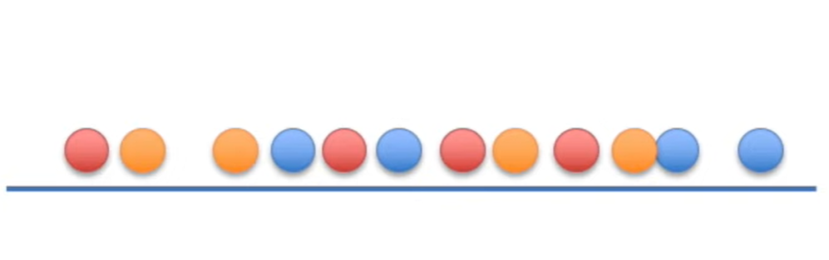
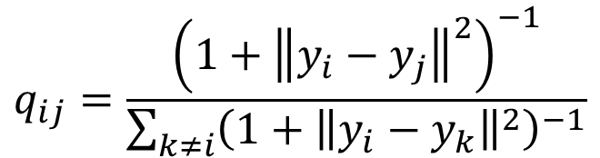
t-distributed Stochastic Neighbor Embedding
$$p_{j|i}=\frac{exp⁡\left({−{\left\|x_{i}−x_{j}\right\|}^{2}}/{2σ_{i}^{2}}\right)}{\sum_{k≠i}{exp⁡\left({−{\left\|x_{i}−x_{k}\right\|}^{2}}/{2σ_{i}^{2}}\right)}}$$
$$p_{ij}=\frac{p_{j|i}+p_{i|j}}{2N}$$
$$q_{ij}=\frac{{\left(1+{\left\|y_{i}−y_{j}\right\|}^{2}\right)}^{−1}}{\sum_{k≠i}{{\left(1+{\left\|y_{i}−y_{k}\right\|}^{2}\right)}^{−1}}}$$

Slide 12
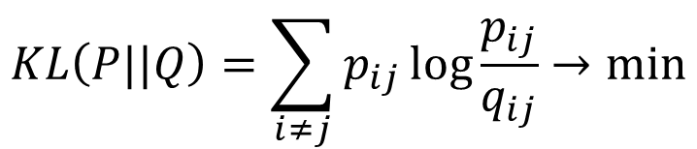
t-distributed Stochastic Neighbor Embedding
$$p_{j|i}=\frac{exp⁡\left({−{\left\|x_{i}−x_{j}\right\|}^{2}}/{2σ_{i}^{2}}\right)}{\sum_{k≠i}{exp⁡\left({−{\left\|x_{i}−x_{k}\right\|}^{2}}/{2σ_{i}^{2}}\right)}}$$
$$p_{ij}=\frac{p_{j|i}+p_{i|j}}{2N}$$
$$q_{ij}=\frac{{\left(1+{\left\|y_{i}−y_{j}\right\|}^{2}\right)}^{−1}}{\sum_{k≠i}{{\left(1+{\left\|y_{i}−y_{k}\right\|}^{2}\right)}^{−1}}}$$
$$KL\left(P||Q\right)=\sum_{i≠j}{p_{ij}\log{\frac{p_{ij}}{q_{ij}}}}→min$$
Дивергенция Кульбака-Лейблера

Slide 13
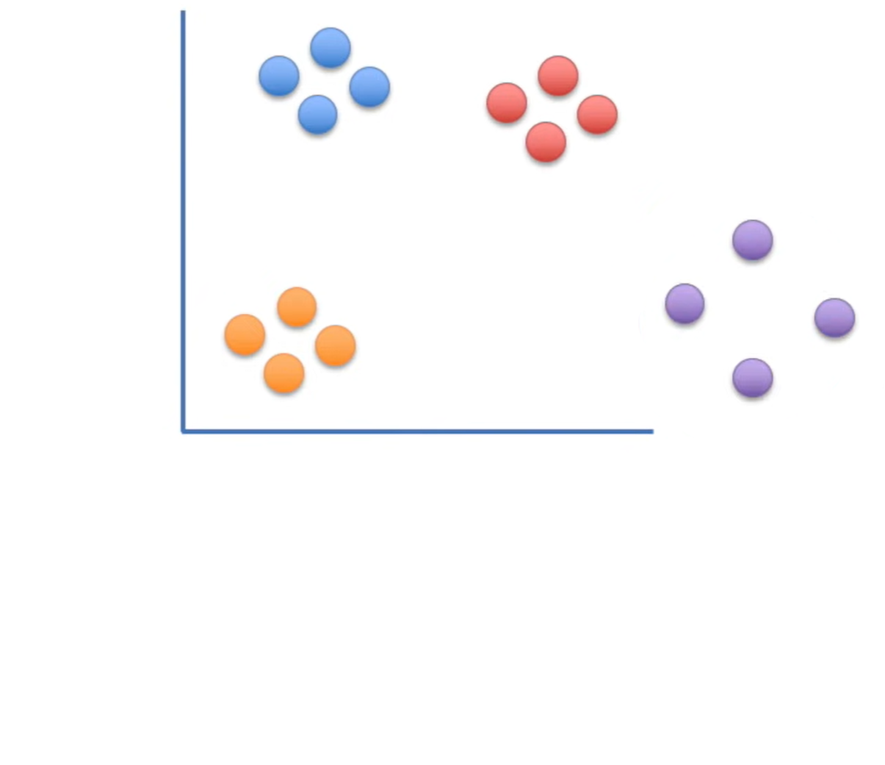
t-distributed Stochastic Neighbor Embedding
$$p_{j|i}=\frac{exp⁡\left({−{\left\|x_{i}−x_{j}\right\|}^{2}}/{2σ_{i}^{2}}\right)}{\sum_{k≠i}{exp⁡\left({−{\left\|x_{i}−x_{k}\right\|}^{2}}/{2σ_{i}^{2}}\right)}}$$
$$p_{ij}=\frac{p_{j|i}+p_{i|j}}{2N}$$

Slide 14
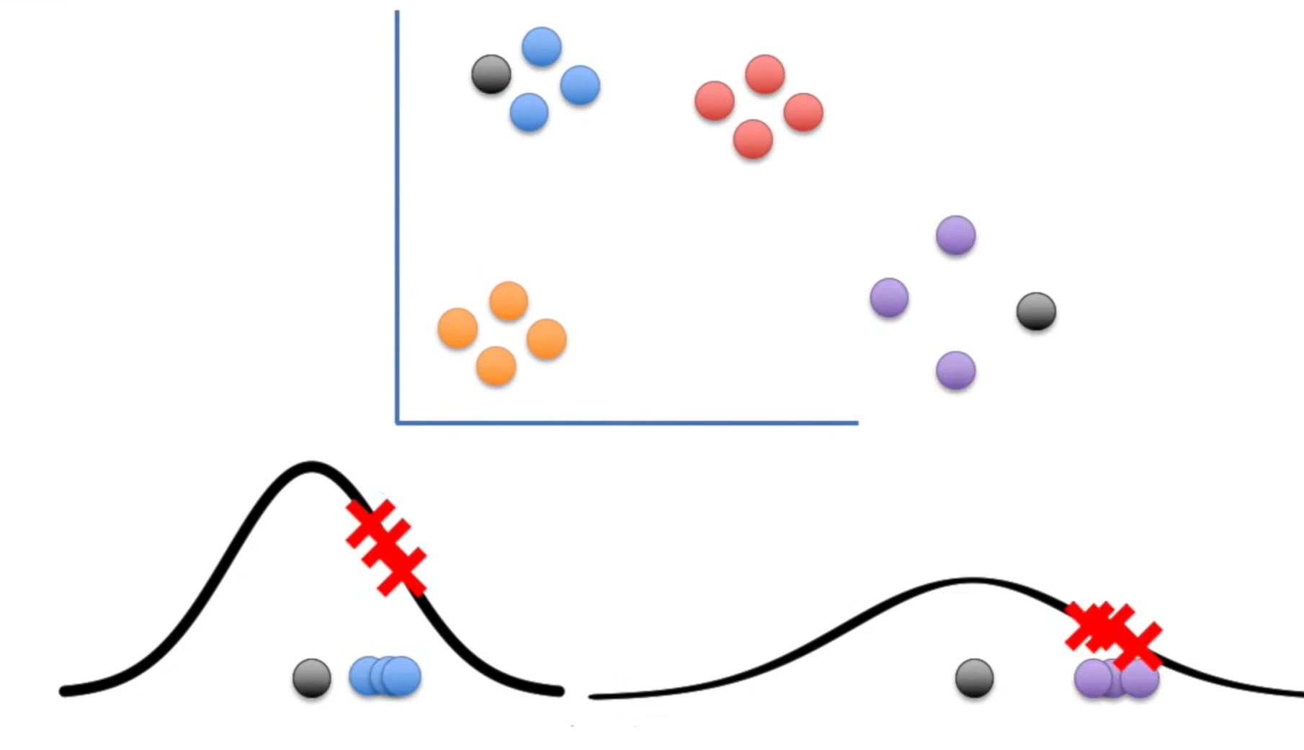

t-distributed Stochastic Neighbor Embedding
$$p_{j|i}=\frac{exp⁡\left({−{\left\|x_{i}−x_{j}\right\|}^{2}}/{2σ_{i}^{2}}\right)}{\sum_{k≠i}{exp⁡\left({−{\left\|x_{i}−x_{k}\right\|}^{2}}/{2σ_{i}^{2}}\right)}}$$
$$p_{ij}=\frac{p_{j|i}+p_{i|j}}{2N}$$
$$Perp\left(P_{i}\right)=2^{−\sum_{j}{p_{j|i}\log{p_{j|i}}}}$$
Перплексия

Slide 15
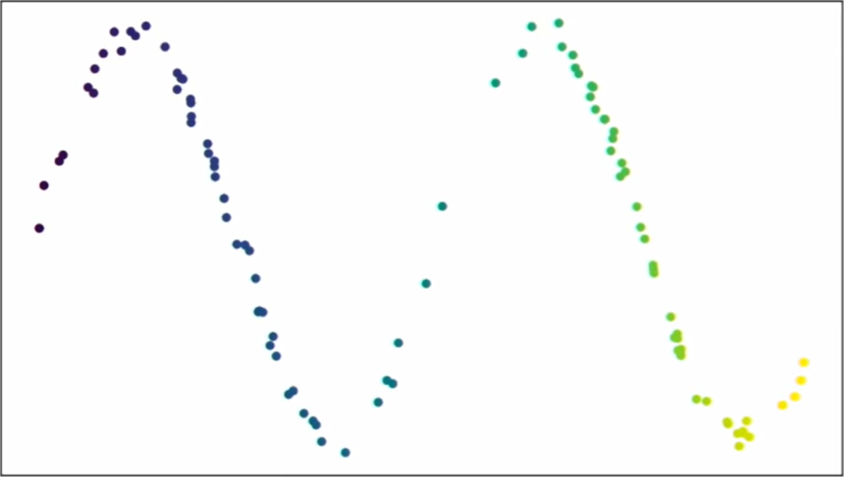
Uniform Manifold Approximation and Projection
https://www.youtube.com/watch?v=nq6iPZVUxZU

Slide 16
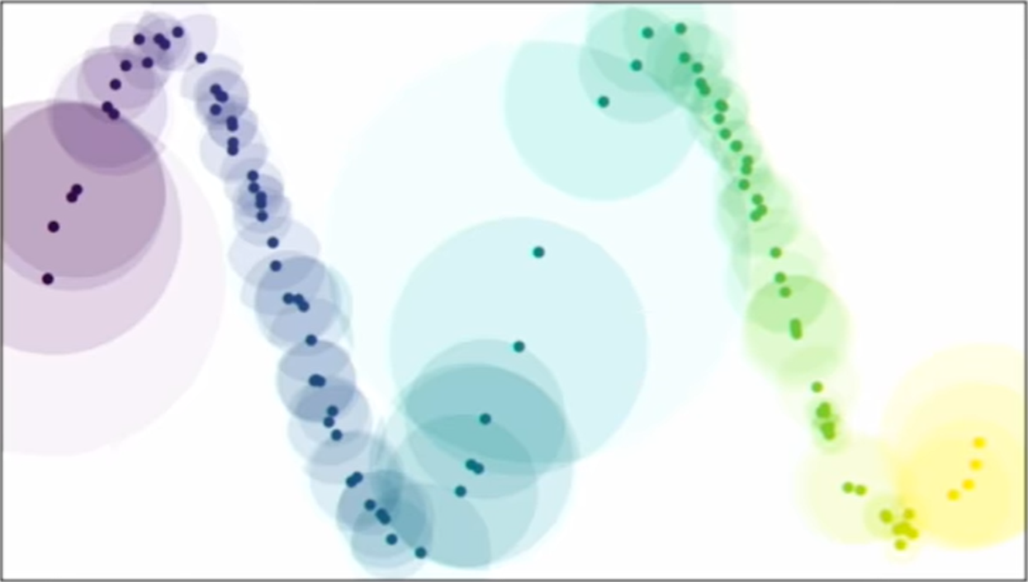

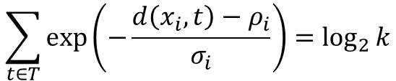

Uniform Manifold Approximation and Projection
https://www.youtube.com/watch?v=nq6iPZVUxZU
$$T=\left\{t_{1},…,t_{k}\right\}$$
$$ρ_{i}=\min_{t∈T}{d\left(x_{i},t\right)}$$
$$\sum_{t∈T}{\exp\left(−\frac{d\left(x_{i},t\right)−ρ_{i}}{σ_{i}}\right)}=\log_{2}{k}$$

Slide 17
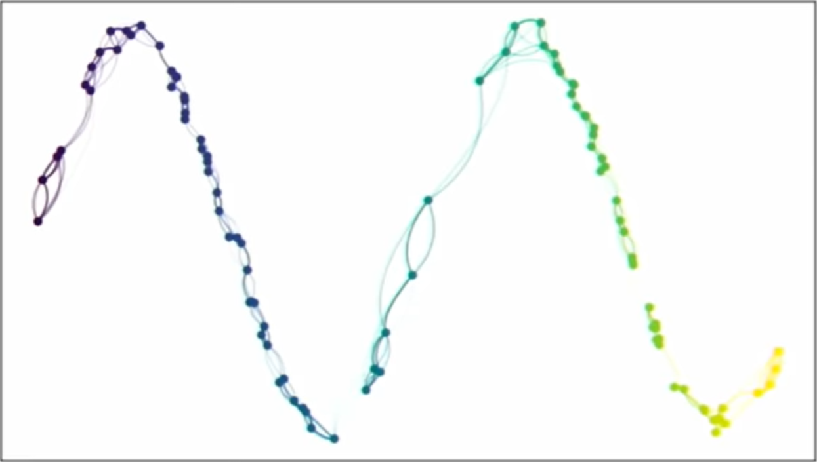
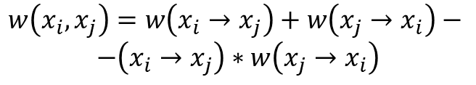

Uniform Manifold Approximation and Projection
https://www.youtube.com/watch?v=nq6iPZVUxZU
$$T=\left\{t_{1},…,t_{k}\right\}$$
$$ρ_{i}=\min_{t∈T}{d\left(x_{i},t\right)}$$
$$\sum_{t∈T}{\exp\left(−\frac{d\left(x_{i},t\right)−ρ_{i}}{σ_{i}}\right)}=\log_{2}{k}$$
$w\left(x_{i}→t_{j}\right)=$ $\exp\left(−\frac{d\left(x_{i},t\right)−ρ_{i}}{σ_{i}}\right)$
$$w\left(x_{i},x_{j}\right)=w\left(x_{i}→x_{j}\right)+w\left(x_{j}→x_{i}\right)−$$
$−\left(x_{i}→x_{j}\right)∗w\left(x_{j}→x_{i}\right)$

Slide 18
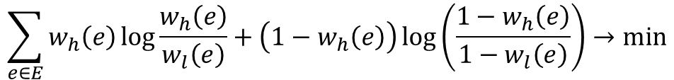
Uniform Manifold Approximation and Projection
https://www.youtube.com/watch?v=nq6iPZVUxZU
$$T=\left\{t_{1},…,t_{k}\right\}$$
$$ρ_{i}=\min_{t∈T}{d\left(x_{i},t\right)}$$
$$\sum_{t∈T}{\exp\left(−\frac{d\left(x_{i},t\right)−ρ_{i}}{σ_{i}}\right)}=\log_{2}{k}$$
$w\left(x_{i}→t_{j}\right)=$ $\exp\left(−\frac{d\left(x_{i},t\right)−ρ_{i}}{σ_{i}}\right)$
$$w\left(x_{i},x_{j}\right)=w\left(x_{i}→x_{j}\right)+w\left(x_{j}→x_{i}\right)−$$
$−\left(x_{i}→x_{j}\right)∗w\left(x_{j}→x_{i}\right)$
$$\sum_{e∈E}{w_{h}\left(e\right)\log{\frac{w_{h}\left(e\right)}{w_{l}\left(e\right)}}+\left(1−w_{h}\left(e\right)\right)\log\left(\frac{1−w_{h}\left(e\right)}{1−w_{l}\left(e\right)}\right)}→min$$

